Slide 1
Apache Cassandra Database

Slide 2
Software Engineering Branch
Database Administration class
BENATHMANE Lalia
👩
Charfaoui Younes & Bourbai Ismail

Slide 3
Hello!
Today we’re going to present the ins and outs of Cassandra database.

Slide 4
Our process is easy
first
second
third
last
Introduction
Key Principles
Demo Example
Debate
Basic of NoSQL, cassandra and the instalation process
The Different aspects of the Cassandra database
An demo illustrating basics of Cassandra query language
Strenghs and Weaknesses, and some questions

Slide 5
Introduction
1
Let’s start with some definitions.

Slide 6
I don’t always use Cassandra,
But when I do, I denormalize
-Meme.

Slide 7
NoSQL Databases
A NoSQL database (Not Only SQL) is a database that provides a mechanism to store and retrieve data other than the tabular relations used in relational databases. These databases are schema-free, support easy replication, have simple API, eventually consistent, and can handle huge amounts of data.

Slide 8
NoSQL Databases
In general, they share the following features:
Schema-free databases
Easy replication support
Simple API
Distributed
Open Source
Huge amount of data
Horizontally scalable

Slide 9

Apache Cassandra
A distributed NoSQL database system for managing large amounts of structured data across many commodity servers, while providing highly available service and no single point of failure.

Slide 10
Caracteristics
Data security
Data sharing
Physical independence
Speed of access
Verification of integrity
Manipulability
Limitation of the roundness
Cassandra support most of the General DBMS characteristics

Slide 11
The Instalation
To strat using cassandra we need to set a workplace for it first.

Slide 12



Requirements:
The latest version of Java 8
The latest version of Python 2.7 or 3.6
Download the Software (DataStax Community Edition for Apache Cassandra™)

Slide 13
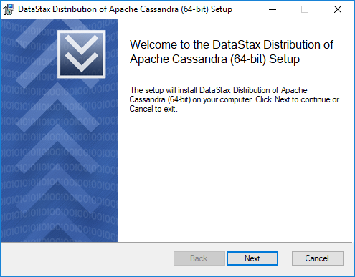
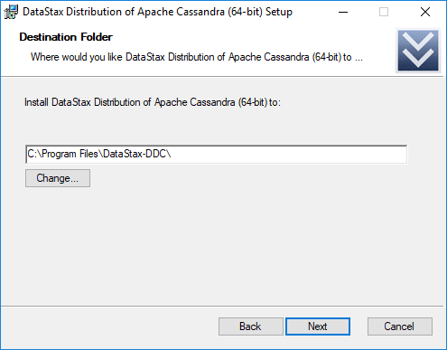
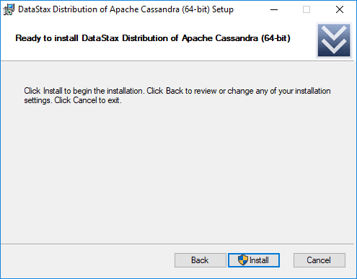
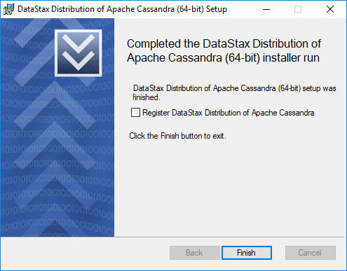

Slide 14

Additional Tool:
You can use DataGrip for interacting with the database instead of the CQLSH, but it does require a license key for using it.
https://www.jetbrains.com/datagrip/

Slide 15
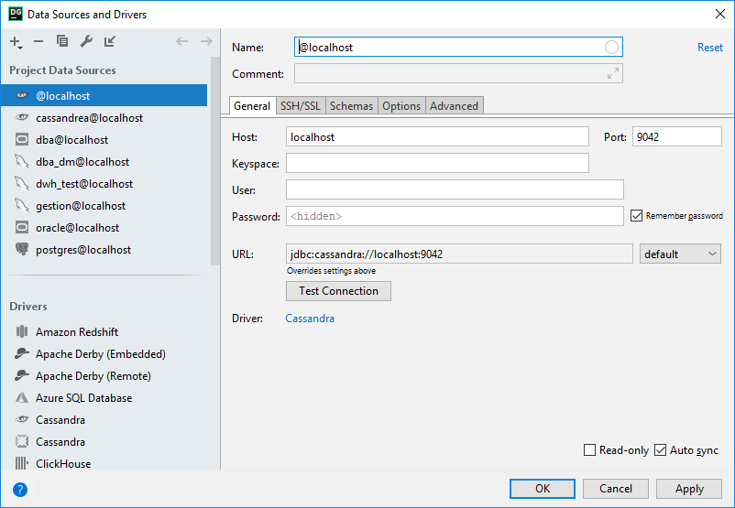
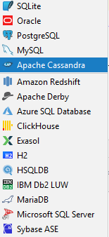
3 – Key Space Name
2 - Connection name
1 – Choose Cassandra

Slide 16
Key Principles
2
The “Must” Be understood of the cassandra

Slide 17
Key Features
High Performance
CQL query interface
Distributed
& Decentralized
Column oriented
This features makes the Cassandra Empire !
Elastic Scalability
Tunable Consistency
Fault Tolerance

Slide 18
Distributed & Decentralized
Distributed: Capable of running on multiple machines
Decentralized: No single point of failure
➢No master-slave issues due to peer-to-peer architecture (protocol "gossip")
Read- and write-requests
to any node

Slide 19
Elastic Scalability
Cassandra scales horizontally, adding more machines that have all or some of the data on
Adding of nodes increase performance throughput linearly
Decreasing and increasing the node count happen seamlessly
Linearly scales to terabytes
and petabytes of data

Slide 20
High Availability & Fault Tolerance
High Availability?
➢Multiple networked computers operating in a cluster
➢Facility for recognizing node failures
➢Forward failing over requests to another part of the system
No single point of failure
due to the peer-to-peer
architecture

Slide 21
Column oriented Key-Value Store
Data is stored in sparse multidimensional hash tables
A row can have multiple columns not necessarily the same amount of columns for each row
Each row has a unique key, which also determines partitioning
R1 | C1 Key | C2 Key | C3Key | …..
 | C1 Value | C3 Value | C3 Value
R2 | C4 Key | C5 Key
 | C4 Value | C5 Value
…….
No relations!

Slide 22
Cassandra Query Language
“CQL 3 is the default and primary interface into the Cassandra DBMS”
Familiar SQL-like syntax that maps to Cassandras storage engine and simplifies data modelling
“SQL-like” but NOT relational SQL

Slide 23
Cassandra Query Language
CRETE TABLE songs (
Id uuid PRIMARY KEY, title text,
Album text, Artist text,
data blob );
SELECT * FROM songs
WHERE id = 'a3e64f8f...';
SELECT * FROM songs ;
INSERT INTO songs (id, title, album, artist)
VALUES( 'a3e64f8f...', ‘Hazim ra3d', ‘Spacetoon', ‘Tarkan‘ );

Slide 24
Cassandra Query Language
INSERT INTO songs (id, title)
VALUES( 'a3e64f8f...', ‘Al Kanas');
This is Possible With Cassandra
😋

Slide 25
Cassandra Query Language
The resulting table in RDMBS is this:
id | title | artist | album | data
a3e64f8f… | Hazim Ra3d | Tarkan | Spacetoon | null
g617Dd23… | Al Kanas | null | null | null

Slide 26
Cassandra Query Language
The resulting table in Cassandra is this:
id | title | artist | album | data
a3e64f8f… | Hazim Ra3d | Tarkan | Spacetoon
g617Dd23… | Al Kanas

Slide 27

MySQL Comparision:
Statistics based on 50 GB Data
 | Cassandra | MySQL
Average Write | 0.12 ms | ~300 ms
Average Read | 15 ms | ~350 ms
Stats provided by Authors using Facebook data.

Slide 28
And Much More…

Slide 29
The Data Model
How the Database is Organized ?

Slide 30
Data Model
Cluster:
Cassandra database is distributed over several machines that operate together. The outermost container is known as the Cluster. For failure handling, every node contains a replica, and in case of a failure, the replica takes charge. Cassandra arranges the nodes in a cluster, in a ring format, and assigns data to them.

Slide 31
Data Model
Keyspace
Outermost container for data (one or more column families), like database in RDBMS.
Column family
Contains Super columns or Columns (but not both).
Column
Basic data structures with: key, value, timestamp

Slide 32
Data Model
🌏
Keyspace
Settings
Column Family
Settings
Column
key
value
timestamp

Slide 33
Demo
3
Example illustrating different part of CQL

Slide 34
Examples Using CQL
The Following Slides will demonstrate different cases with different CQL interfaces like DDL, DML etc..
User
Emails
Id
Name
Phone
Age
Id
email

Slide 35
Interface DDL
DROP
Type
Index , Trigger
CREATE
Type
ALTER
Type
Keyspace , Table
Keyspace , Table
Index , Trigger
Keyspace , Table
Index , Trigger
Same as SQL, but with keyspaces and types option added.

Slide 36
Interface DML
DML
SELECT
INSERT
UPDATE
DELETE
The DML Interface is the Same With Normal SQL DML

Slide 37
Interface DCL
USER
CREATE
DROP
PERMISSION
GRANT
REVOKE
VIEW
LIST USERS
LIST PERMISSION
ALTER
Create users (Roles), give them permission, and start using them.

Slide 38
Interface TCL
START
BEGIN BATCH
OPERATIONS
DMLs
END
APPLY BATCH
For multiple operations use the BATCH command

Slide 39
Email Example
CRETE TABLE users (
Id uuid PRIMARY KEY,
name text,
phone text,
age text,
emails set<text> );

Slide 40
Metadata & Logging
How to see metadata and make logging in Cassandra database ?

Slide 41
Metadata Using Describe
Describe keyspace name
keyspace
Table
Describe table keyspace__name .table_name
Describe keyspaces, tables, schema
Others

Slide 42
Metadata Keyspace
Query the defined key spaces using the SELECT statement.
SELECT * FROM system________schema._keyspaces
keyspace__name | durable__writes | replication
test | True | {'class': 'org.apache'}….
…… | …… | ……

Slide 43
Metadata Tables
Getting information about tables in the test keyspace.
SELECT * FROM system__schema.tables WHERE keyspace__name = test';
keyspace__name | table__name | …….
test | users | ……..
…… | …… | ……

Slide 44
Metadata Columns
Getting information about columns in the users tables.
SELECT * FROM system__schema.columns
WHERE keyspace__name = test' AND table__name = 'users';
table__name | column___name | kind | type | …….
users | age | regular | int | ……..
…… | …… | …… | …… | ……

Slide 45
Logging with System.log
To see what is happening in the database, you can use the system.log file in the Cassandra home to directory to track creational query.
{CASSANDRA HOME}/\utils/\cassandra.logdir_IS_UNDEFINED/

Slide 46
Logging with System.log
Here is an Example
INFO [main] 2018-11-08 23:48:36,960 MigrationManager.java:302 - Create new Keyspace: KeyspaceMetadata {name=system_traces, params=KeyspaceParams {durable_writes=true, replication=ReplicationParams {class=org.apache.cassandra.locator.SimpleStrategy, replication_factor=2 }

Slide 47
Logging with Tracing
It’s an option to activate in the Cassandra database
TRACING [ ON | OFF]
The result will be on different keyspace called system__traces. In a table called events
USE system_traces;
SELECT * FROM events;

Slide 48
Logging with Tracing
Example:
INSERT INTO product(id , name) VALUES (UUID(), 'Hello');
Result:
Execute CQL3 query
Parsing insert into product(id , name) values(UUID(), 'Hello');
Preparing statement
……

Slide 49
Debate
4
Strength and weakness of Cassandra.

Slide 50
Strengths (1)
Linear scale performance
The ability to add nodes without failures leads to predictable increases In performance
Supports multiple languages
Python, C#/.NET, C++, Ruby, Java, Go, and many more…
Operational and developmental simplicity
There are no complex software tiers to be managed, so administration duties are greatly simplified.

Slide 51
Strengths (2)
Ability to deploy across data centers
Cassandra can be deployed across multiple, geographically dispersed data centers
Cloud availability
Installations in cloud environments
Peer to peer architecture
Cassandra follows a peer-to-peer architecture, instead of master-slave architecture

Slide 52
Strengths (3)
Flexible data model
Supports modern data types with fast writes and reads
Fault tolerance
Nodes that fail can easily be restored or replaced
High Performance
Cassandra has demonstrated brilliant performance under large sets of data

Slide 53
Strengths (4)
Schema-free/Schema-less
In Cassandra, columns can be created at your will within the rows. Cassandra data model is also famously known as a schema-optional data model
AP-CAP
Cassandra is typically classified as an AP system, meaning that availability and partition tolerance are generally considered to be more important than consistency in Cassandra

Slide 54
Weaknesses (1)
Use Cases where is better to avoid using Cassandra
If there are too many joins required to retrieve the data
To store configuration data
During compaction, things slow down and throughput degrades
Basic things like aggregation operators are not supported
Range queries on partition key are not supported

Slide 55
Weaknesses (2)
Use Cases where is better to avoid using Cassandra
If there are transactional data which require 100% consistency
Cassandra can update and delete data but it is not designed to do so

Slide 56
Thanks!
Any questions?

